Slide 1

SuperBigBite DAQ update

Slide 2
Outline
SBS requirements
Fastbus Readout
FADC HCAL readout
GEM readout
Timeline
Manpower

Slide 3
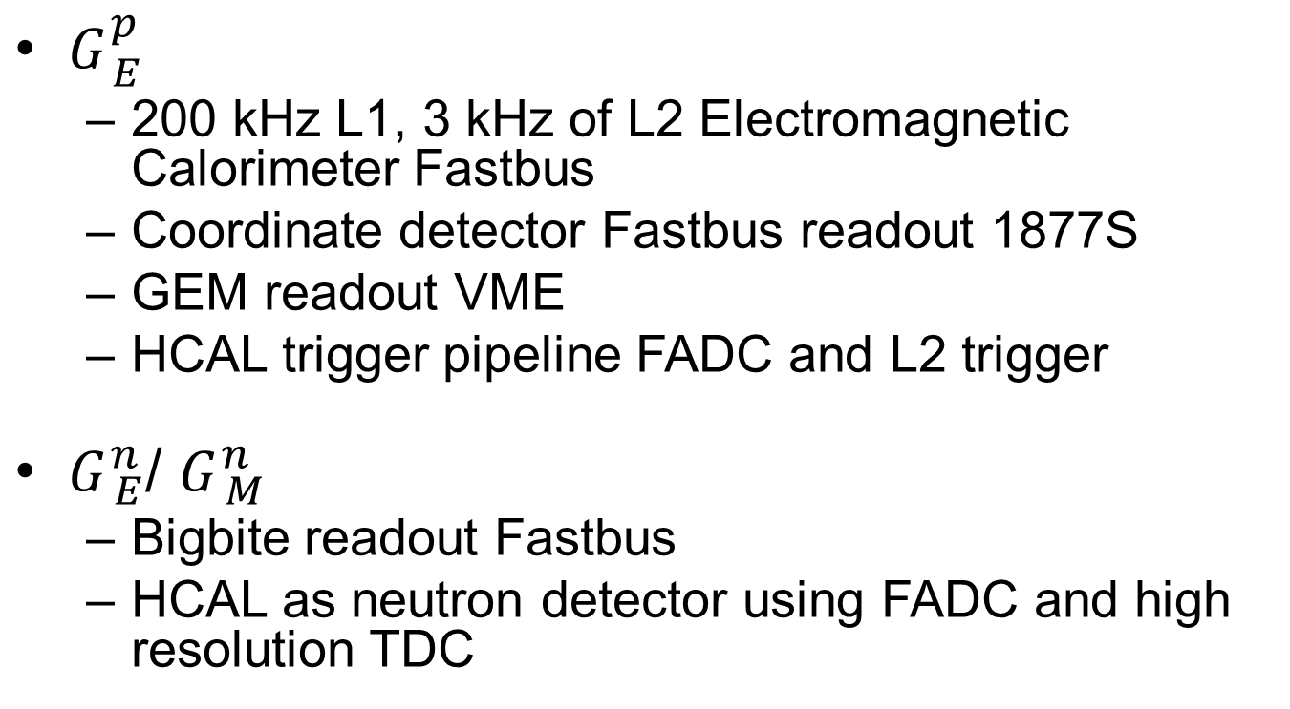
SBS DAQ requirements
$G_{ E}^{p}$
200 kHz L1, 3 kHz of L2 Electromagnetic Calorimeter Fastbus
Coordinate detector Fastbus readout 1877S
GEM readout VME
HCAL trigger pipeline FADC and L2 trigger
$G_{ E}^{n}$/ $G_{ M}^{n}$
Bigbite readout Fastbus
HCAL as neutron detector using FADC and high resolution TDC

Slide 4
Fastbus update
Use new CODA 3.0 TI and TS
More flexibility in programming
Event blocking
Absolute timestamp for synchronization check
Trigger partitioning capability only use a subset of modules
Asked for modified firmware to DAQ group in May 2015 ( William Gu and Bryan Moffit )
Firmware being developed and tested

Slide 5
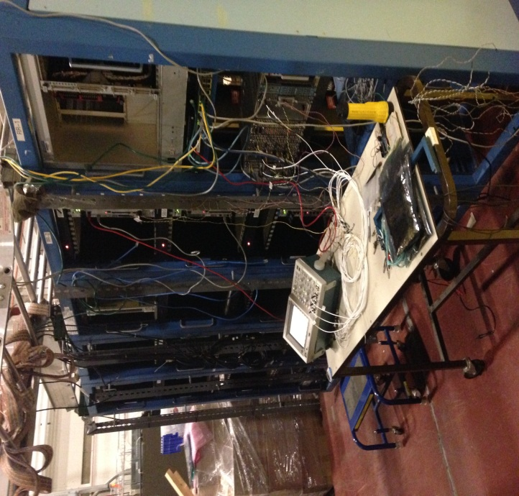
Fastbus update
Have sufficient TDCs, ADCs, crates, aux. cards
Like to scrounge ~3 more SFI (Struck Fastbus Interface)
(backup plan: fewer crates, reduced performance)
Making FB faster
sparsification – works
event blocking – works
event switching – being tested
merging with pipelining VME -- to be tried
Three large Fastbus systems are being
assembled for test in the test lab.
have 236
need 124
have 113
need 94
have 30
need 21

Slide 6
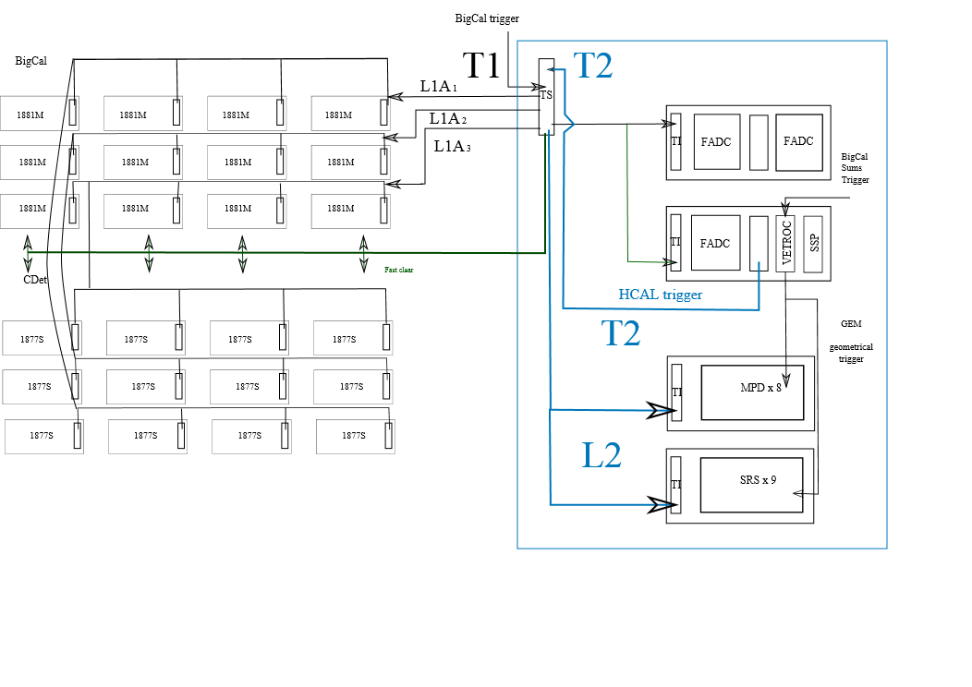
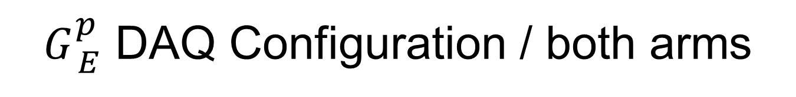
$G_{ E}^{p}$ DAQ Configuration / both arms
Fastbus
L2
L2
L2
T2 distributed to Hadron and Electron Arms;
if no L2A, Fast Clear to Fastbus

Slide 7
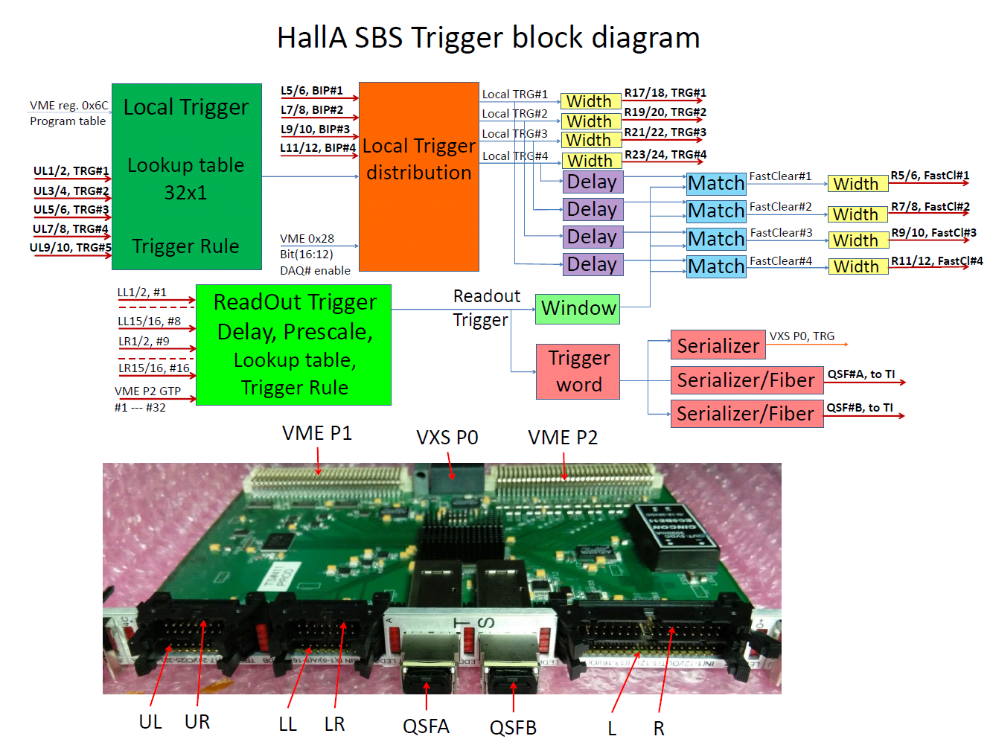

Slide 8
Single Crate, Buffer Level = 4
No Pedestal
Suppression (8ADCs)
Local trigger ~ 50 kHz
Local trigger ~ 100 kHz
Local trigger ~ 200 kHz
Dead time at
Local ~ 200 kHz and Readout ~5kHz
D₁ ~40%
Pedestal
Suppressed
Expected ~ 5000 Hz

Slide 9
3 Crates, Buffer Level = 4
No Pedestal
Suppression (8ADCs)
Local trigger ~ 50 kHz
Local trigger ~ 100 kHz
Local trigger ~ 200 kHz
Dead time at
Local ~ 200 kHz and Readout ~5kHz
D₃ ~6%
Pedestal
Suppressed
D₃ ~ (D₁)³
Expected ~ 5000 Hz

Slide 10
Readout trigger rate ~ 5kHz, Buffer Level = 4, No pedestal suppression (8ADC)
1 crates
2 crates
3 crates

Slide 11
HCAL
All FADC 16 delivered
2 VXS crates delivered
2 Intel Concurrent CPU delivered
Readout tested
Development of trigger using HPS firmware and GTP
New VTP ordered

Slide 12
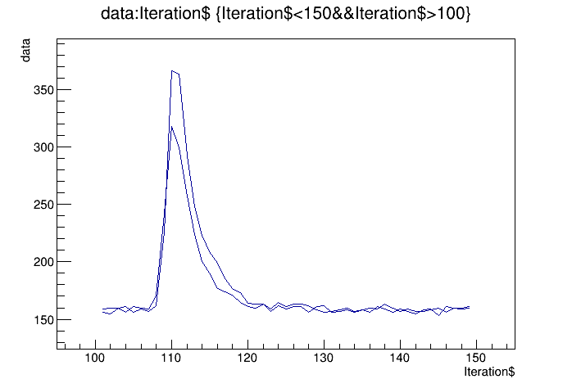
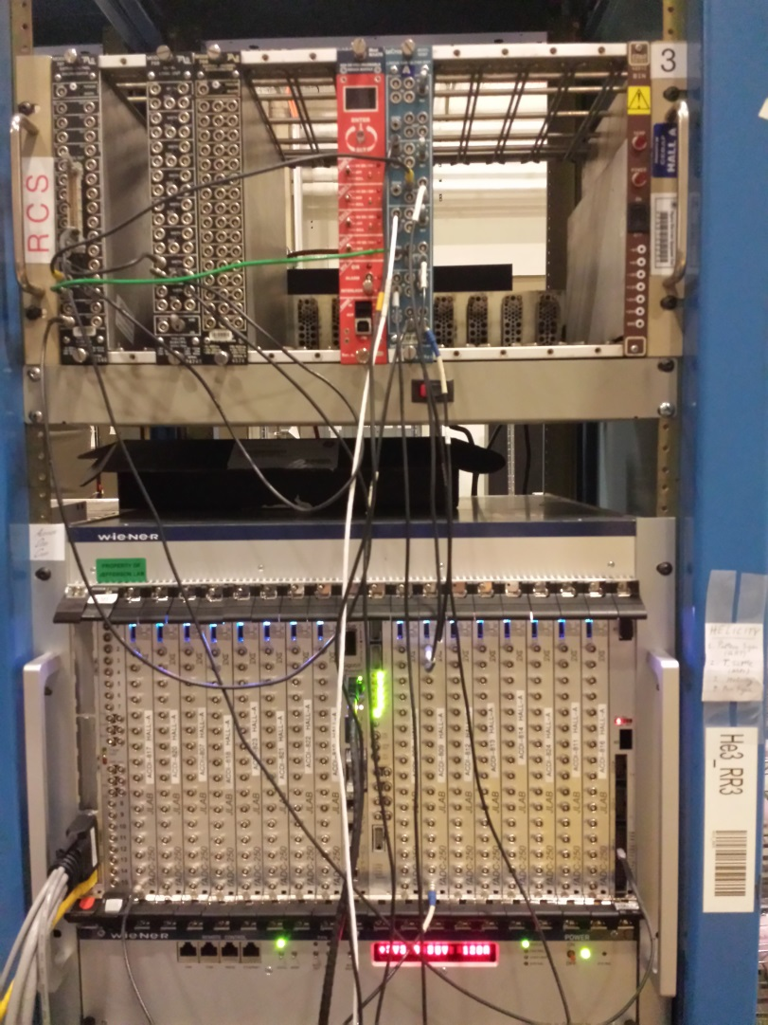
HCAL FADC electronics
Cosmics from calorimeter block
Will test later with HCAL module

Slide 13
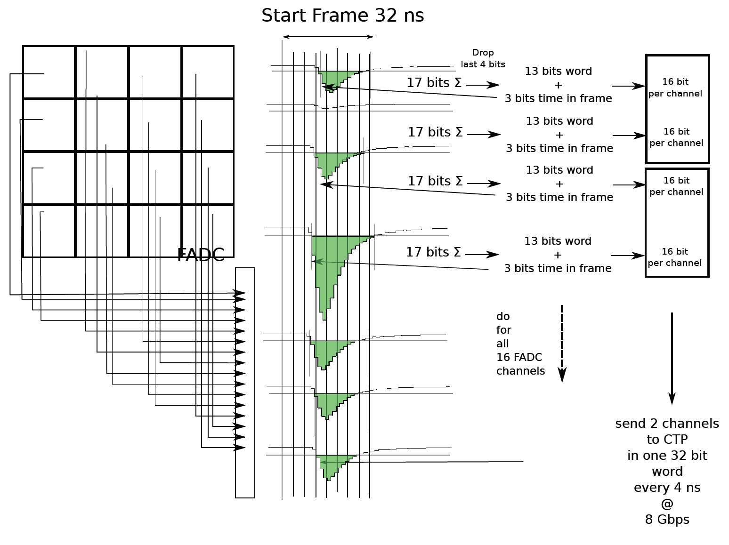
Hadron Arm - HCAL DAQ: proton trigger
HCal Signals to FADC inputs
2 VME switched Serial (VXS) Crates
JLAB FADC250, a 16-channel 12-bit FADC sampling at 250 MHz
16 FADC in VXS Crate 1
2 FADC in VXS Crate 2
If signal pass threshold
Integrates signal and subtracts pedestal
Sends time frame info
VTP (Crate Trigger Processor)
Located in VXS crates
Collects integrated signal and timing from FADC channels
Sends data to the second VTP for clustering

Slide 14
HCAL trigger development
HPS firmware installed on FADC and GTP
FADC readout tested with cosmics
Testing triggering capability
Need
implement decoder for analysis
Test using 2 crates and new VTP

Slide 15
GEM MPD readout
INFN MPD used for several years using custom C++ package
Package ported to intel CPU
New C library written for easy integration into CODA
( Bryan Moffit, Evarsito Cisbani, Danning Di )
CODA configuration running
Debugging module initialization

Slide 16
Status MPD
VME part seems to work
Data structure looks fine but no data from APV
Maybe issue with communication with APV (I2C timing ) being investigated

Slide 17
GEM optical link readout
Aurora protocol based
2 Gbit optical link : 250 MB/s per link
Readout up to 32 MPD in parallel : 8 GB/s bandwidth compared to 100 MB/s using VME
SSP readout library being tested
Link from MPD to SSP module working from Ben Raydo
MPD functions implementation in Optical module in progress by Paolo Musico

Slide 18
Timeline
4th quarter 2015 | 1st quarter 2016 | 2st quarter 2016 | 3rd quarter 2016
Finish MPD CODA readout - debug Finish Fastbus Readout – debug Small scale setup Test 200 KHz L1 and 5 kHz coinc with Fastbus, MPD, and HCAL FADC Cdet Fastbus Analysis software : check synchronization Test MPD optical readout HCAL trigger ordered | Implement new HCAL Trigger module HCAL cosmics GEM cosmics with MPD Test GEM readout with optical link in high background at UVA Develop GEM analysis software | GEM installed on BigBite for tritium experiment ECal cosmics Parasitic test during DVCS : Fastbus and FADC setup | Tritium experiment Parasitic test during Tritium : Fastbus and FADC setup

Slide 19
Manpower
Fastbus
JLAB : Dasuni Adikaram, Mark Jones, Robert Michaels, Bryan Moffit, William Gu
MPD
INFN : Evaristo Cisbani, Paolo Musico
UVA : Danning Di, Kondo Gnanvo, Nilanga Liyanage
JLAB : Ben Raydo, Bryan Moffit
Stony Brook : Seamus Riordan
HCAL
JLAB : Alexandre Camsonne, Ben Raydo, Bryan Moffit

Slide 20
Conclusion
Fastbus flipping module close to be complete
Preliminary results show acceptable dead time in experiment conditions
Need to develop software and check synchronization
HCAL : FADC ready, trigger implemented and being tested
MPD : CODA readout implemented, debugging of the C code, Optical readout in progress
Small scale test setup in a few weeks

